Slide 1

Introducing… ClutterCutter!
The smart, effective tool for your messy inbox

Slide 2

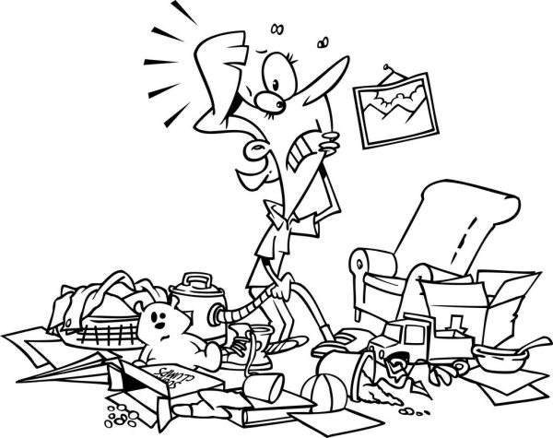
Introduction and Motivation
The Problem
A messy, disorganized inbox makes life more complicated than it needs to be.
Why do we need a solution?
To save valuable time
To make email search easier
To increase the quality of life

Slide 3
The Solution Process
Provide examples of how we sort past emails
Apply ML to learn the patterns
Apply this knowledge to make predictions
Automated sorting for future emails!

Slide 4
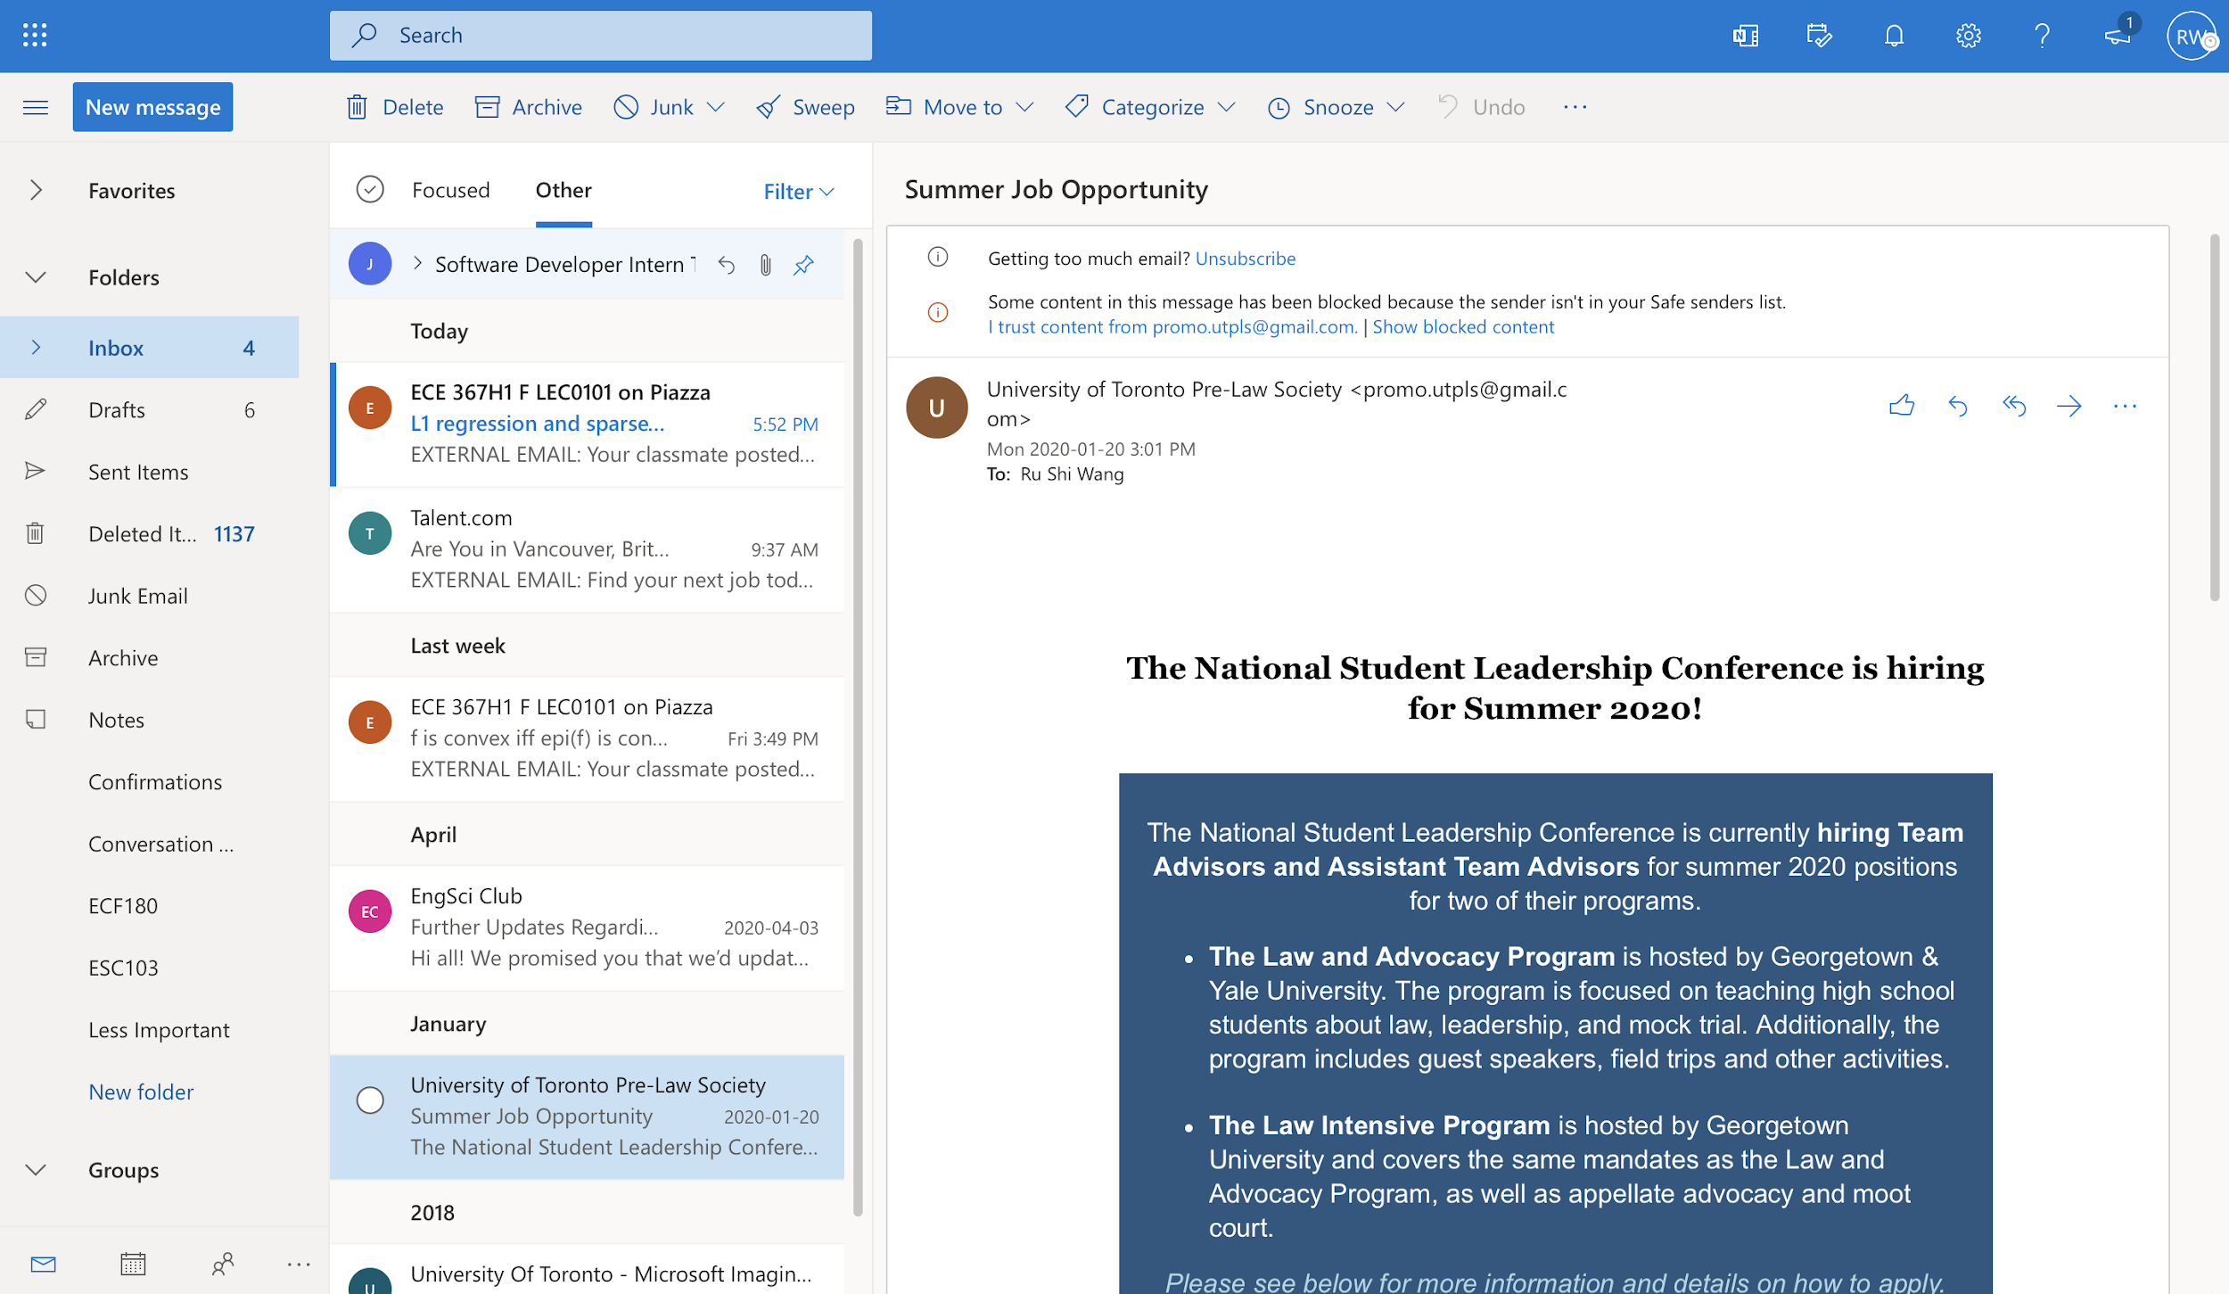
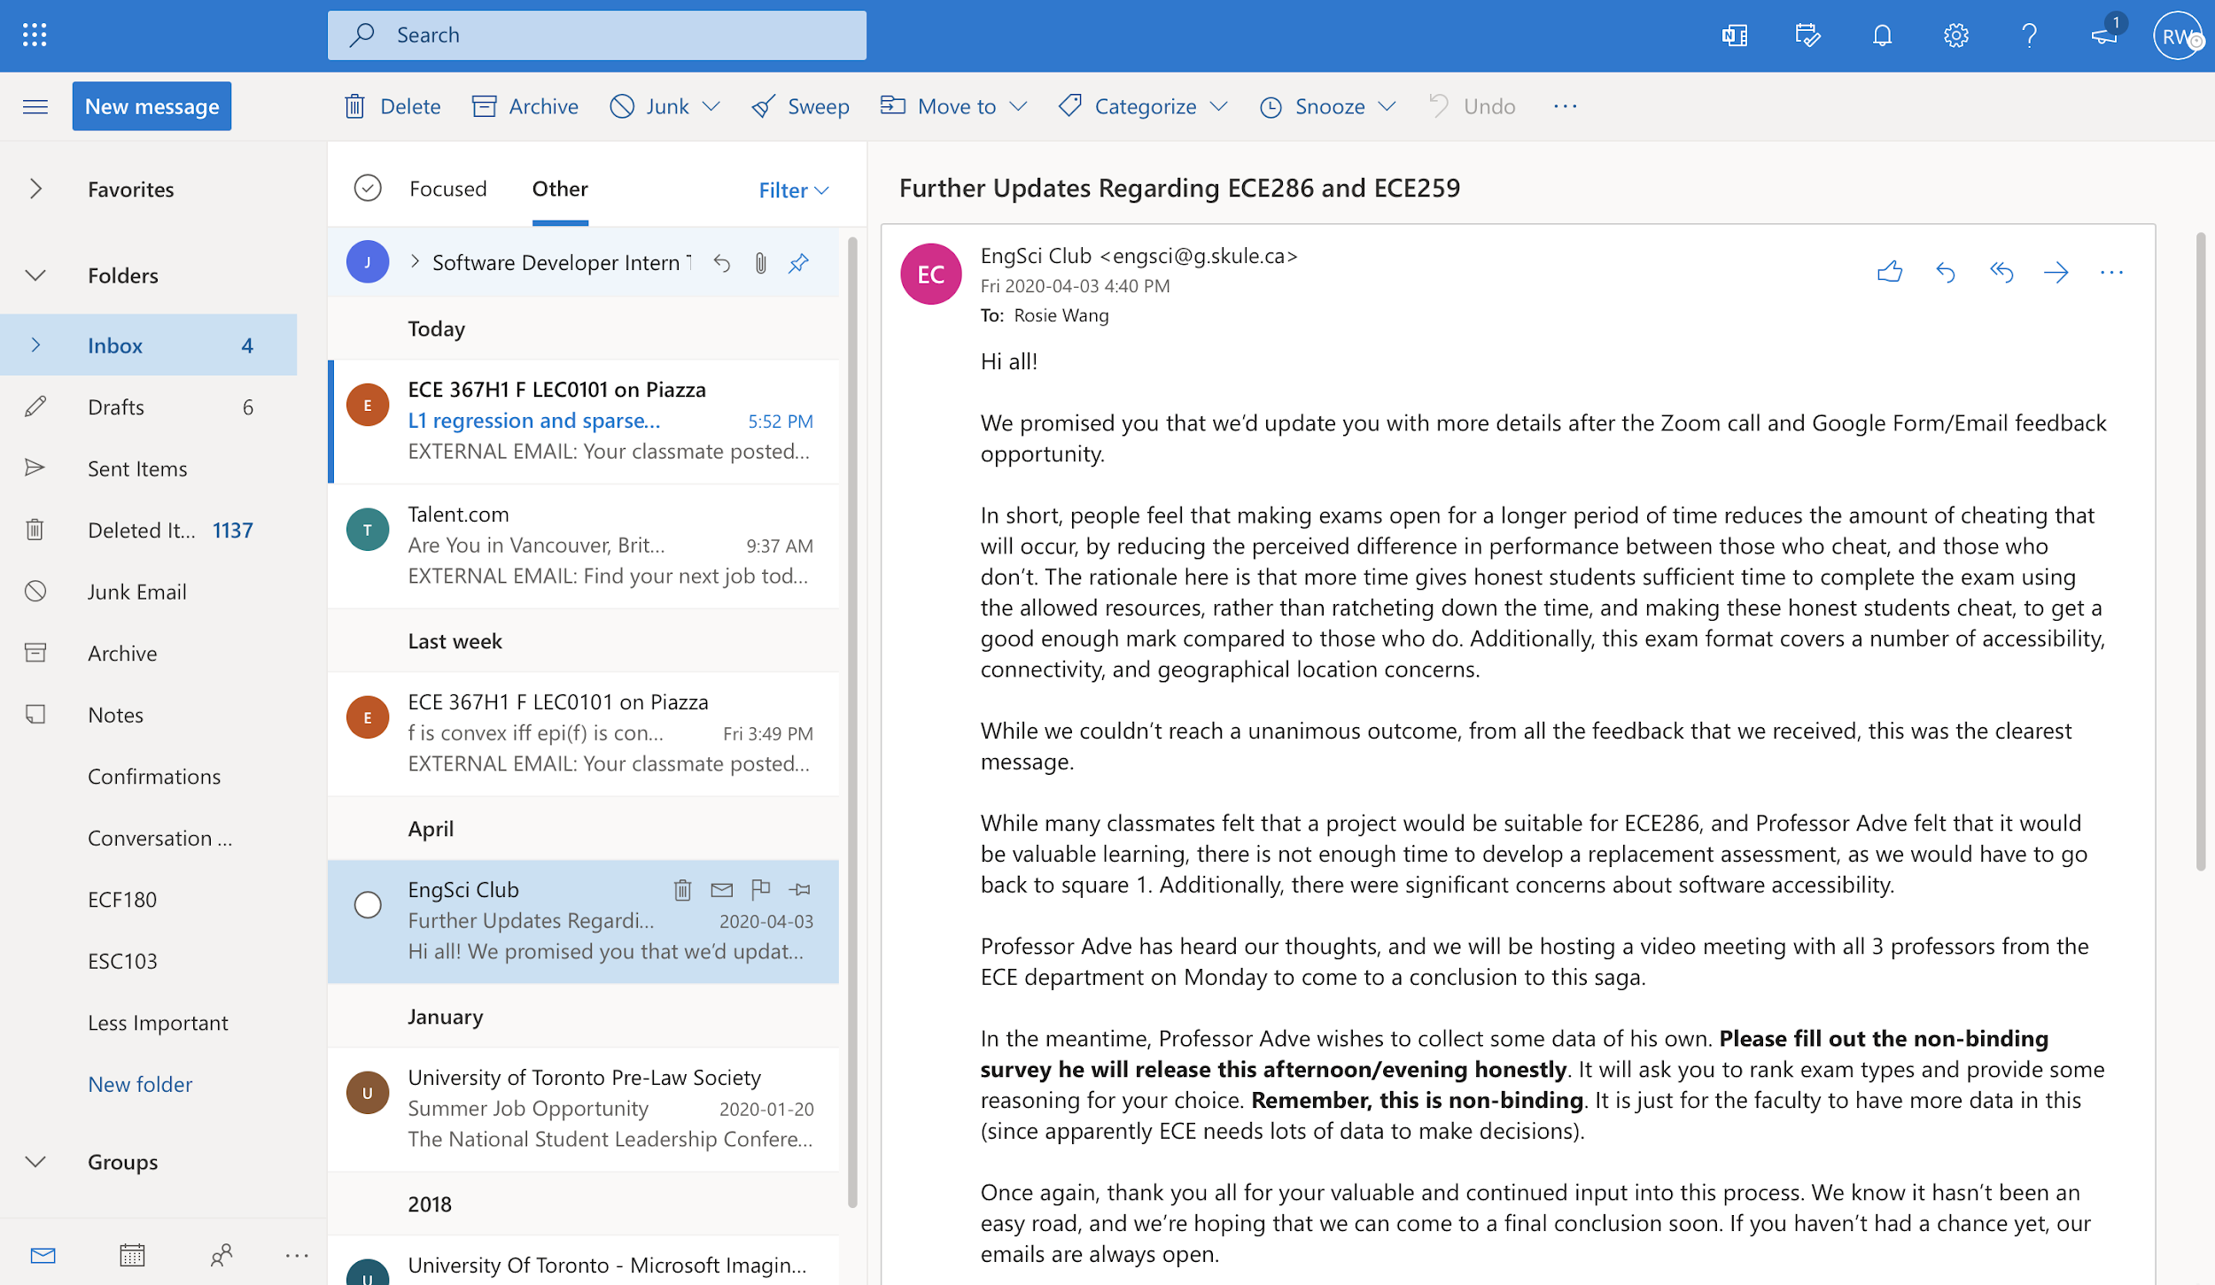
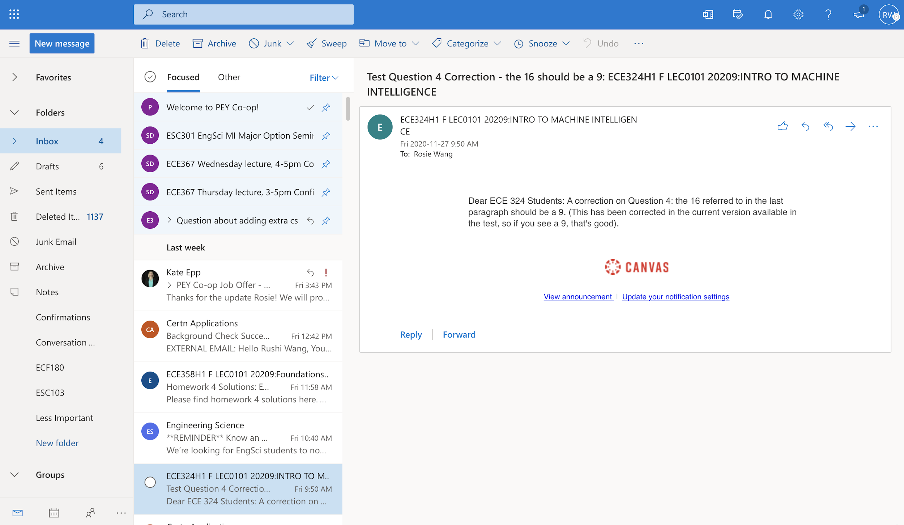
Data &
Data Processing
Data Used
Real-life emails from our own accounts
Data Cleaning
Standardized text
Removed personal info for privacy reasons
Amount of Data
Initial: 150/class for a total of 750
Re-sampling: Increased to ~200/class for ~1000 total
Data Augmentation: Increased to 2850 total
Synonym Replacement
Back Translation
Notes:
Standardized -> lowercasing, punctuation, number stripping, etc.
Final dataset was quite balanced

Slide 5

Data Statistics
8872 unique words in 2850 emails!
Below are the 5 most frequently appearing “meaningful” words for each category
Academics:
'course': 124, 'students': 121, 'final': 82, 'questions': 82, 'engineering': 81
Alerts:
'order': 218, 'email': 169, 'account': 147, 'password': 71, 'information': 70
Personal:
'practice': 45, 'think': 32, 'going': 20, 'other': 19, 'email': 19
Professional:
'application': 177, 'interview': 145, 'position': 100, 'interest': 68, 'assessment': 59
Promotions and Events:
'students': 275, 'engineering': 198, 'november': 151, 'student': 144, 'university': 143
Notes:
alerts: 'order': 218, 'email': 169, 'please': 149, 'account': 147, 'password': 71, 'information': 70
academics: 'course': 124, 'students': 121, 'about': 83, 'final': 82, 'questions': 82, 'engineering': 81, 'student': 67, 'question': 63, 'academic': 60, 'posted': 59, 'faculty': 57, 'office': 54, 'courses': 54
professional: 'application': 177, 'please': 162, 'interview': 145, 'thank': 133, 'position': 100, 'interest': 68, 'about': 66, 'assessment': 59, 'process': 54, 'email': 53, 'would': 53, 'experience': 46
personal: 'practice': 45, 'please': 36, 'should': 35, 'think': 32, 'would': 32, 'about': 28, 'could': 24, 'going': 20, 'other': 19, 'email': 19, 'meeting': 18, 'first': 18, 'everyone': 17, 'attend': 17, 'really': 16, 'before': 16, 'thank': 16
promotion and events:'students': 275, 'engineering': 198, 'november': 151, 'student': 144, 'university': 143, 'about': 137, 'please': 118, 'online': 112, 'research': 102, 'toronto': 91, 'information': 91, 'learn': 88, 'first': 78, 'program': 77, 'their': 77, 'event': 75, 'events': 74, 'virtual': 71, 'faculty': 71, 'through': 69, 'learning': 69, 'career': 68, 'health': 68, 'email': 62, 'engsci': 62
TEST: Examples in each class
3 118
1 116
2 113
4 111
0 111
Name: label, dtype: int64
TRAIN: Examples in each class
3 376
1 370
2 363
4 355
0 355
VALIDATION: Examples in each class
3 94
1 93
2 91
0 89
4 88

Slide 6

Data Statistics
cont.d...
Data Splits
Training = 0.64
Validation = 0.16
Test = 0.20
Class Balance
Labels | Train | Validation | Test
Academics | 355 | 89 | 111
Alerts | 370 | 93 | 116
Personal | 363 | 91 | 113
Professional | 376 | 94 | 118
Promotions and Events | 355 | 88 | 111
Notes:
Academics:
'COURSE': 112, 'STUDENTS': 110, 'PLEASE': 108, 'ENGINEERING': 81, 'FINAL': 65, 'QUESTIONS': 64, 'ABOUT': 63, 'STUDENT': 57, 'ACADEMIC': 48,
'OFFICE': 47
Alerts:
'ORDER': 161, 'EMAIL': 135, 'PLEASE': 102, 'ACCOUNT': 94, 'THANK': 51, 'NUMBER': 47, 'INFORMATION': 46, 'ADDRESS': 45, 'PASSWORD': 45, 'RECEIPT': 35

Slide 7
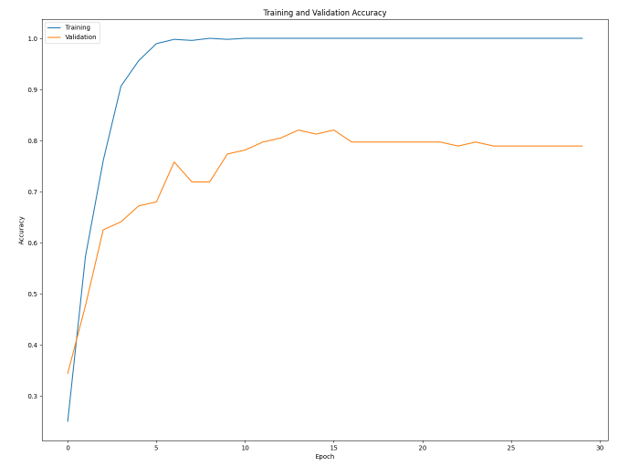
Case 1: No Data Augmentation
Notes:
Comment on effects of each step of processing
Case 1: No data augmentation
Case 2: Partial (0.35) augmentation
Case 3: Full (0.5) augmentation

Slide 8
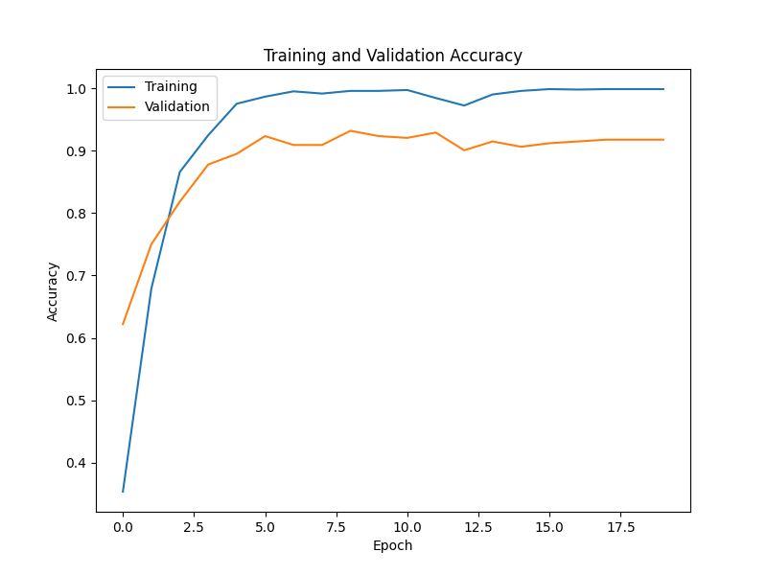
Case 2: 35% Data Augmentation
Notes:
Comment on effects of each step of processing
Case 1: No data augmentation
Case 2: Partial (0.35) augmentation
Case 3: Full (0.5) augmentation

Slide 9
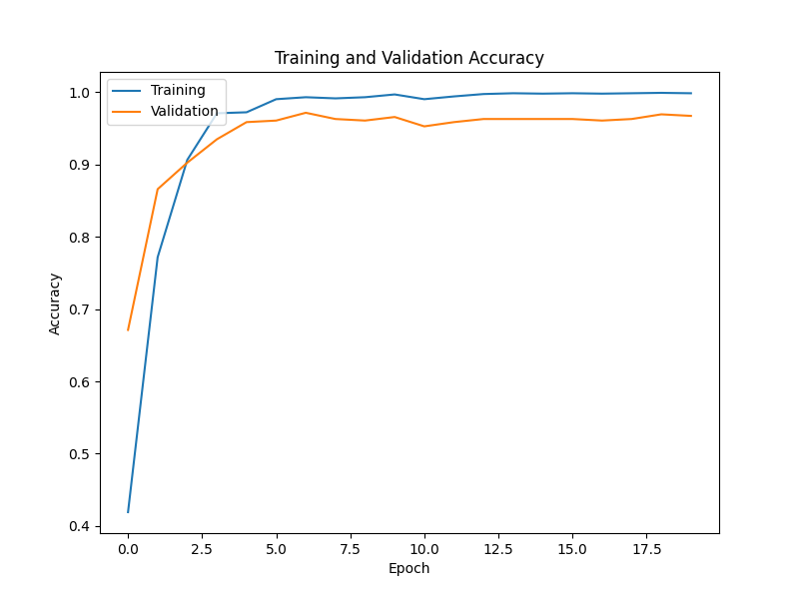
Case 3: 50% Data augmentation
Notes:
Comment on effects of each step of processing
Case 1: No data augmentation
Case 2: Partial (0.35) augmentation
Case 3: Full (0.5) augmentation

Slide 10
Our Model
Vectorization
Word embeddings using Fasttext
Baseline
Took average meaning of each email
Fed to linear layer to produce 5 outputs
RNN
Single GRU unit
Initial hidden dimension = 50
Fed to linear layer to produce 5 outputs
Notes:
Mention hidden dimension and why we chose, segue into hyperparameter search.

Slide 11
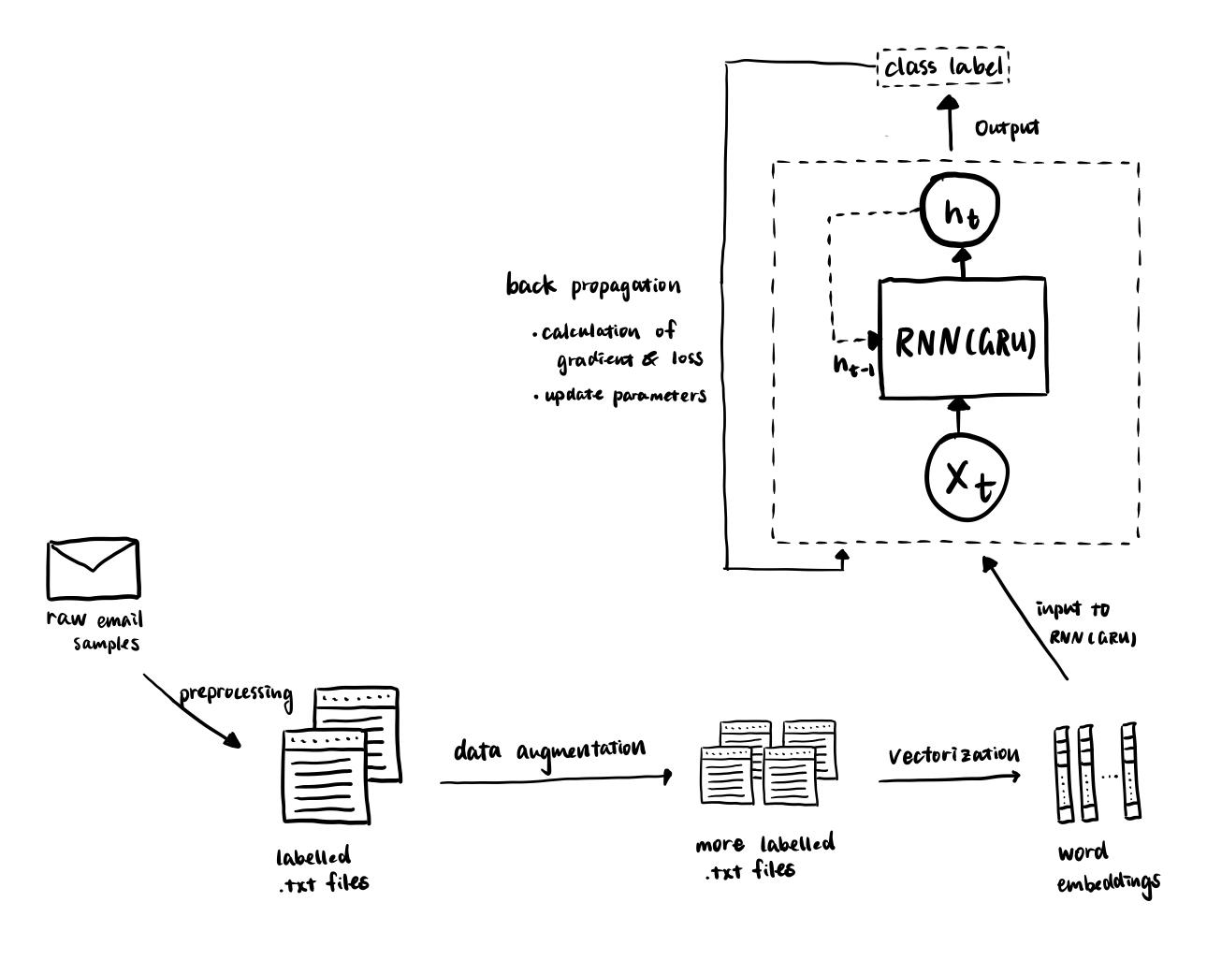

Slide 12
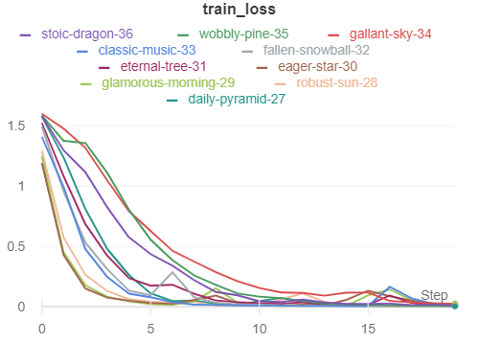
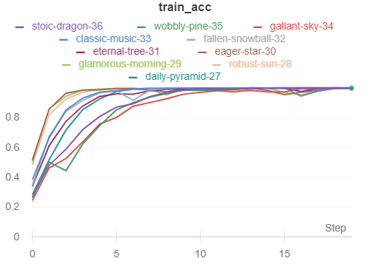
Hyperparameter Search: Loss and Accuracy Curves

Slide 13
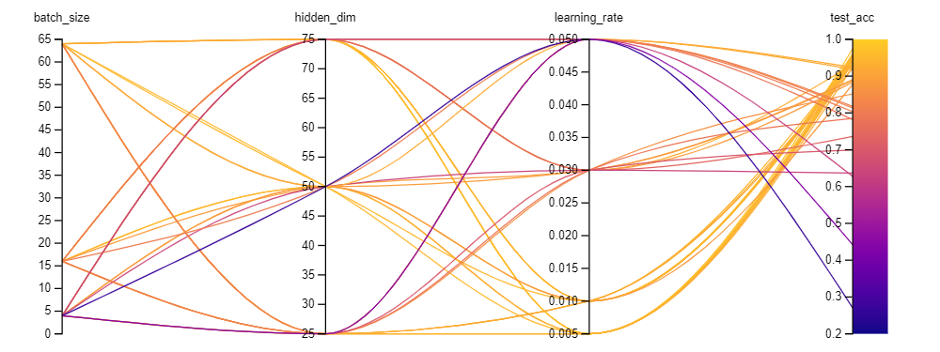
Summary Sweep of Hyperparameters
Notes:
Discuss correlation with higher batch size, mid-to-high hidden_dim, low learning_rate

Slide 14

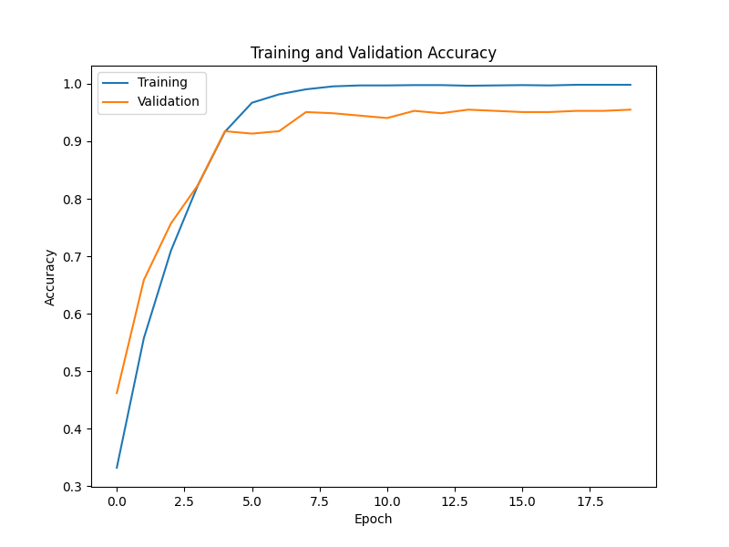
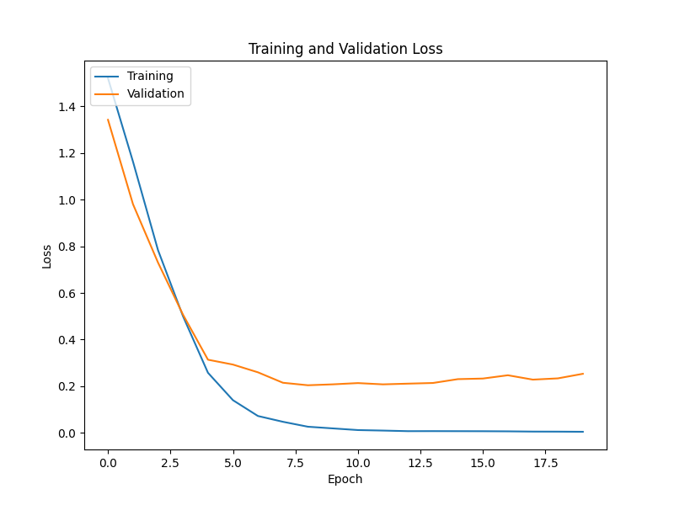
Best Model
Test Accuracy: 96.65%
Hyperparameters: Batch size - 32, Learning rate - 0.005, Hidden dimension - 75
Notes:
Give Hyperparameters

Slide 15
Video Demo

Slide 16

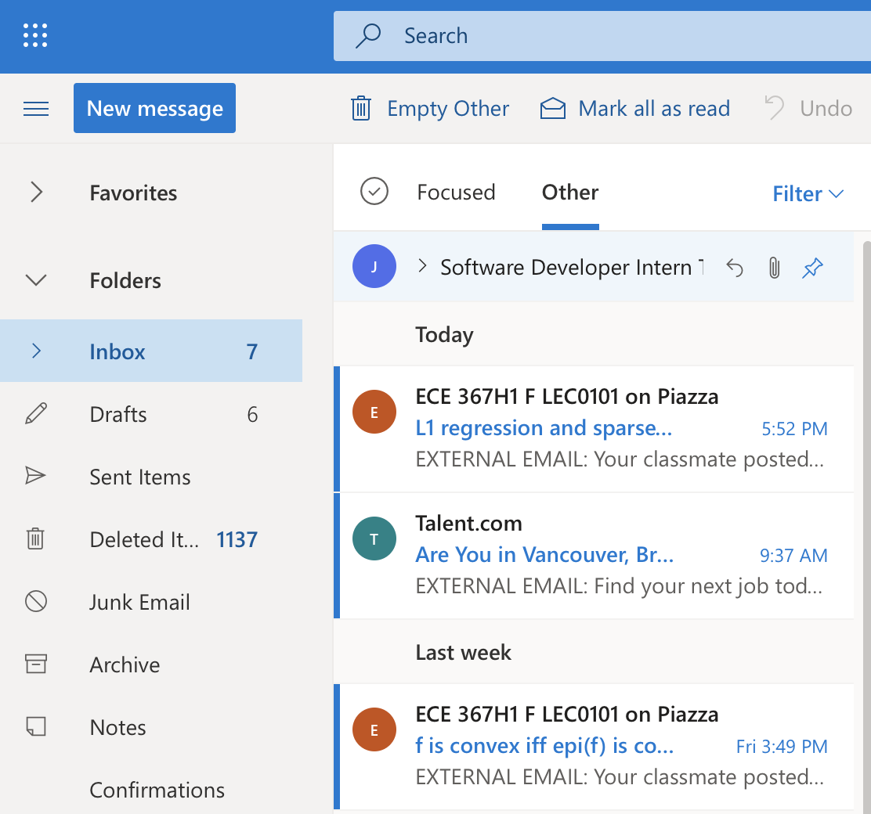
Video Summary
From the video we saw
Ex 1: Question from Piazza was correctly predicted as Academics
Ex 2: Ad for job opportunities was predicted as Promotions & Events
These examples were from new emails the model has never seen!

Slide 17
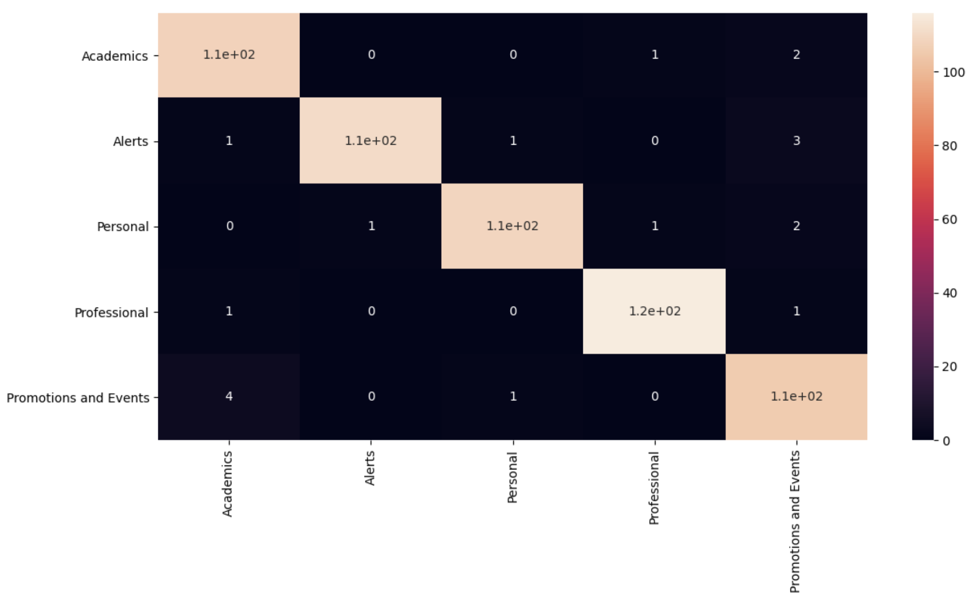
Visualizing Errors
The poorest performing class was Promotions & Events
Actual P&E got confused for Academics
Most samples falsely labeled as P&E

Slide 18
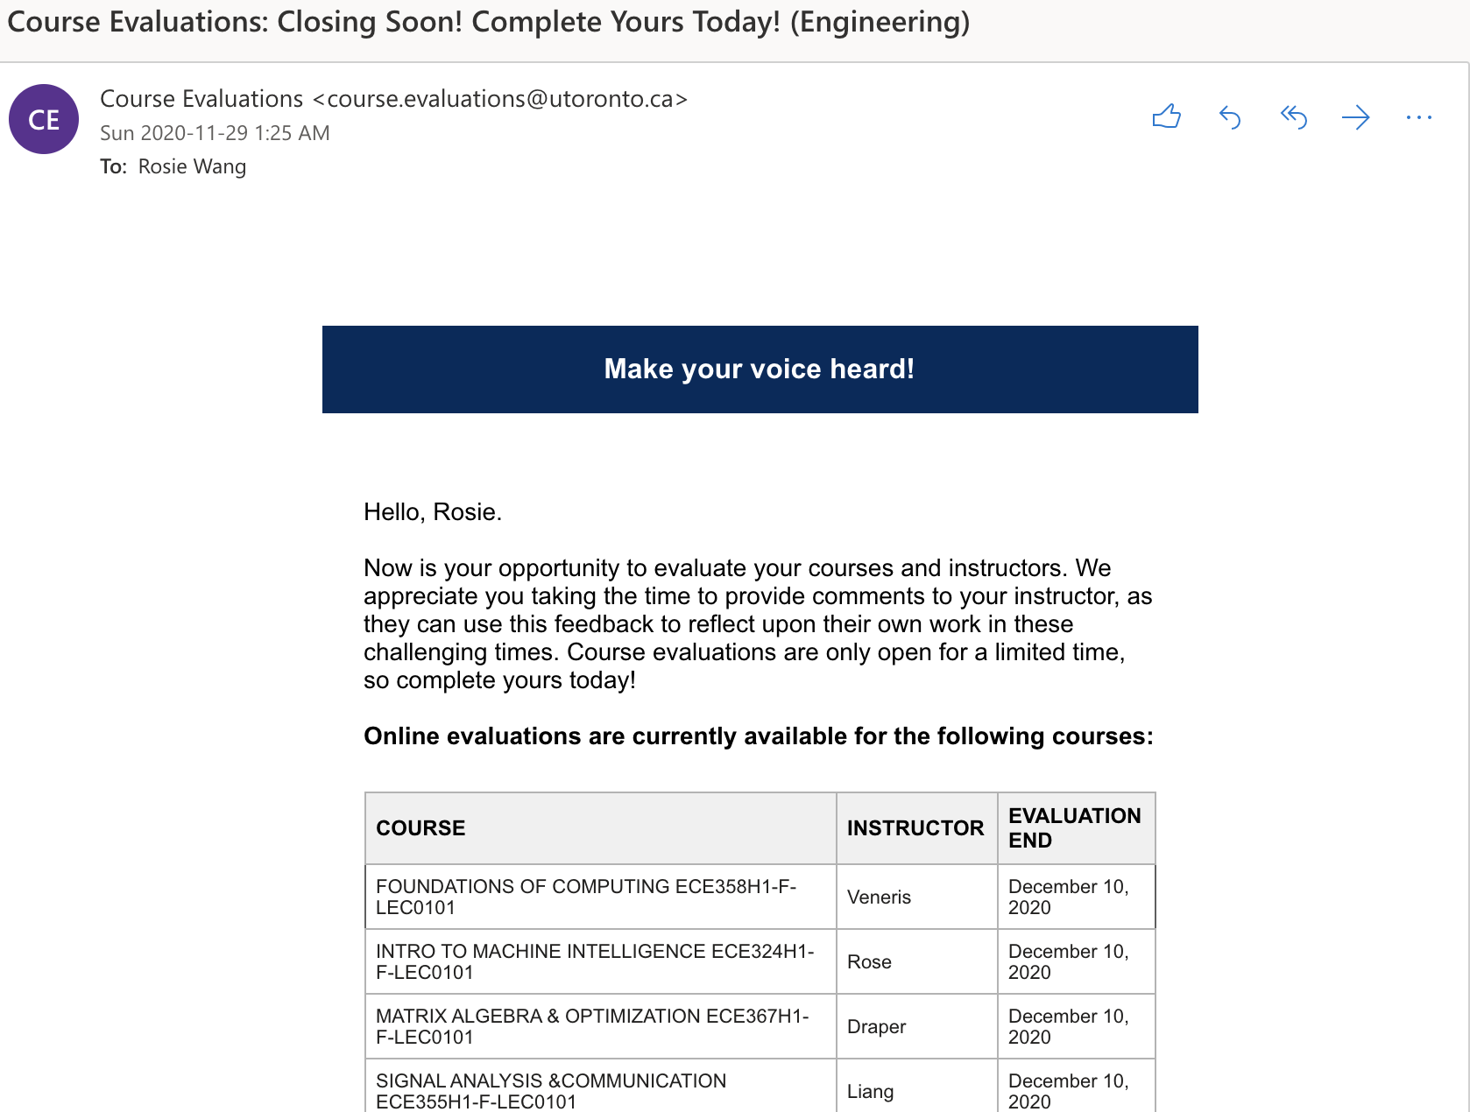

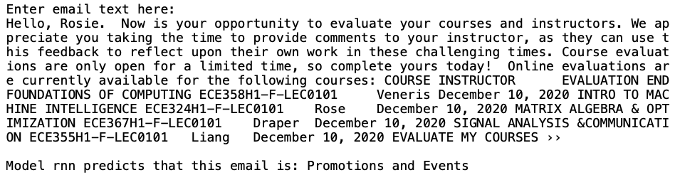
Examples of Incorrect Predictions 1
Prediction: Promotions & Events
Ground Truth: Academics

Slide 19
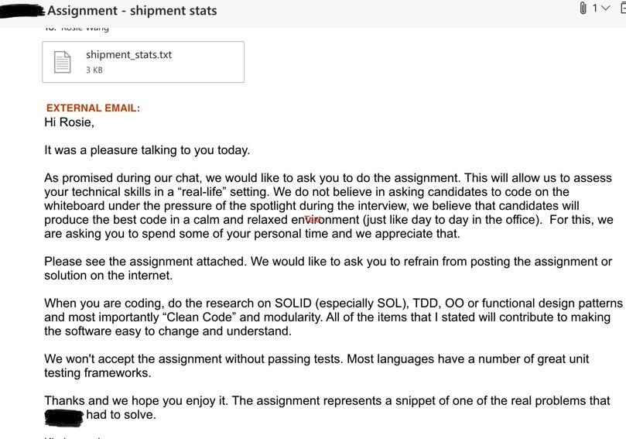
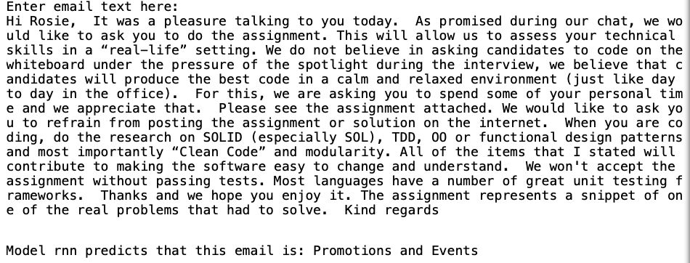
Examples of Incorrect Predictions 2
Prediction: Promotions & Events
Ground Truth: Professional

Slide 20
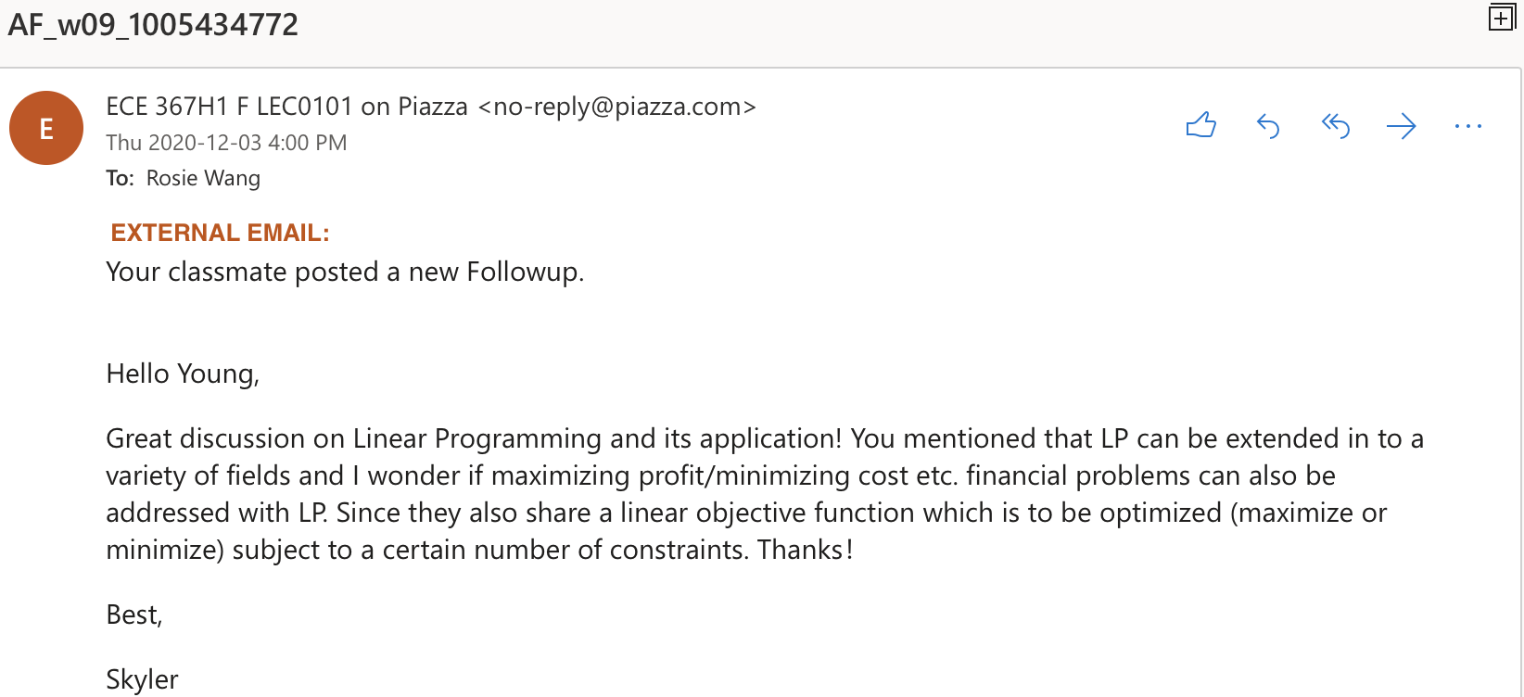
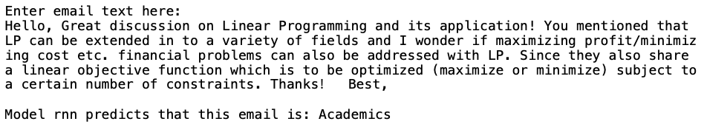
Ignore this

Slide 21
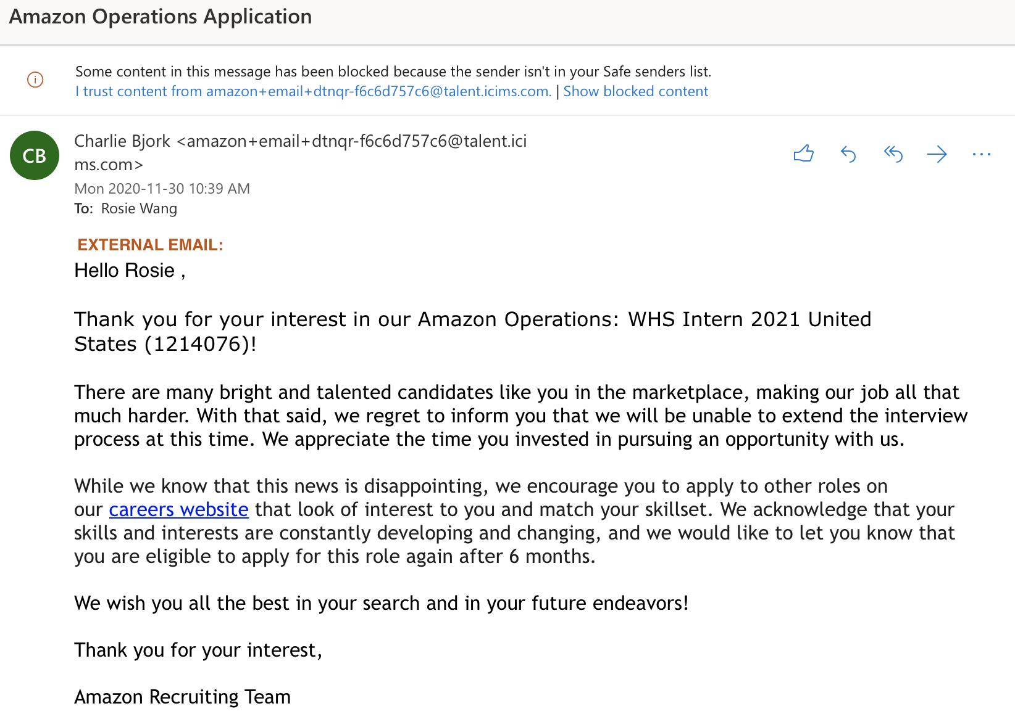
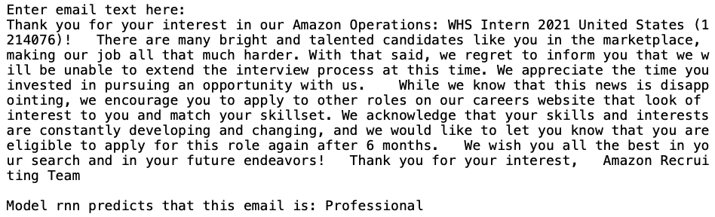
Ignore this too

Slide 22

Discussion
We have high test accuracy… but:
Data source (¾ Engineering + ¼ Artsci = 100% UofT)
Only tested on emails in our accounts
May not generalize!
Keyword frequency implies category:
Recall the most common words in each category
“Course” → Academics
“Order” → Alerts
“Application” → Professional
“Students” → Promotion & Events
“Practice” → Personal

Slide 23
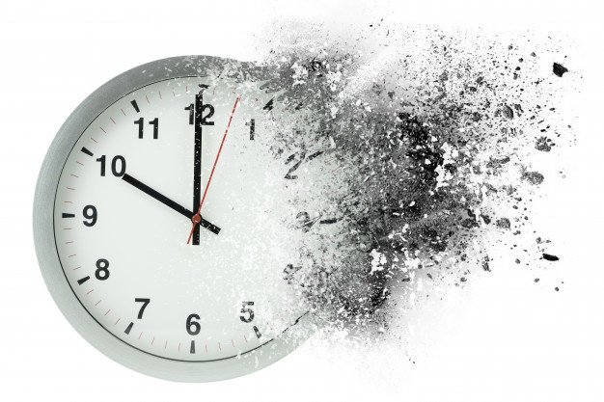

What we learned
Preparing raw data takes time!
Need enough
Manual cleaning
Need to be VERY clear on the scope of the labels
Notes:
Subjectiveness in sorting. Reading, sorting, copying, and pasting 1000+ emails took a long time

Slide 24



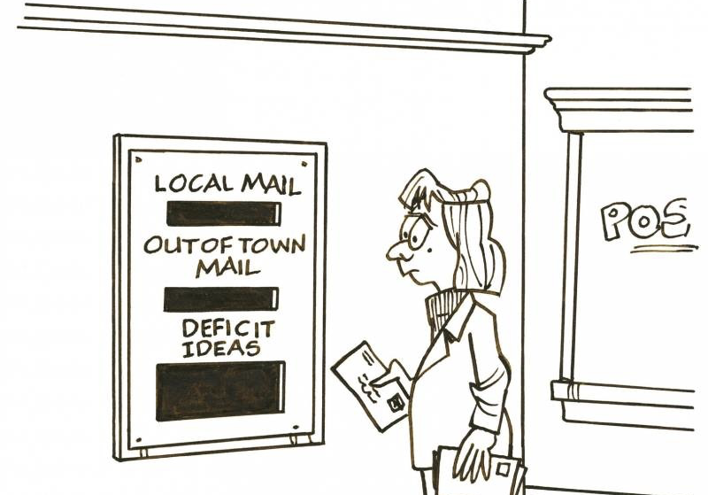
Things to Consider
Generalization for all users?
User choice for labels?
Managing typos?
Incorporation of decision heuristics into NN design?
Notes:
Heuristics examples: name of sender, presence of key words, presence of visuals, etc.

Slide 25
Any Questions?

